Slide 1
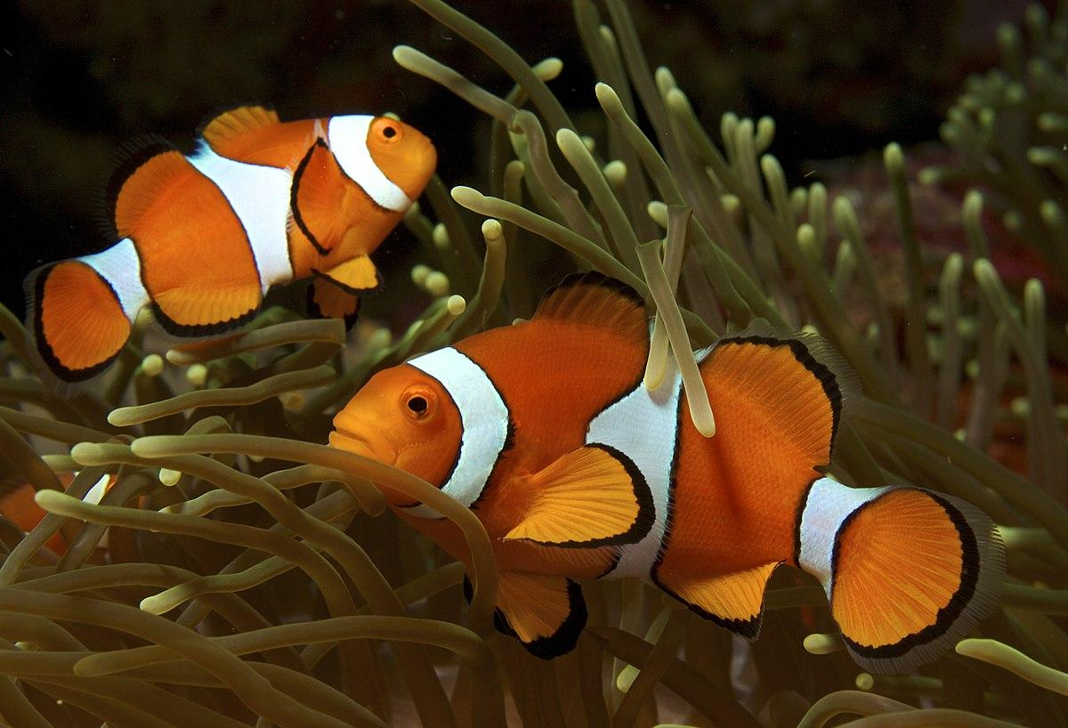
Virtual Biogeography
Emily Kroft,
Étienne Lacroix-Carignan,
Jenna LeBlanc,
Amanda Liczner,
Trang Indigo Tran
Notes:
Indigo: Our project aims to verify the bio-geo-graphy accuracy of a piece of media. So we choose Finding Nemo as an example for this project for multiple reasons.

Slide 2
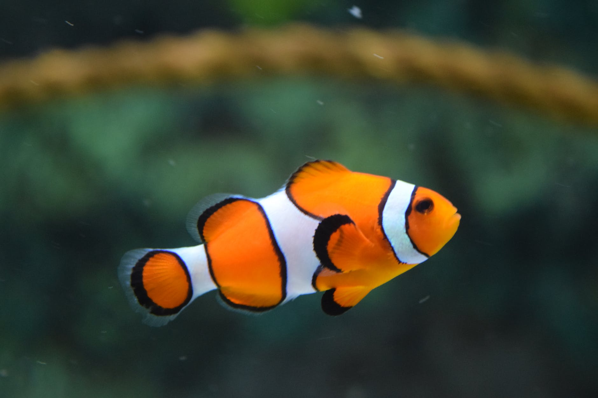
Quick Finding Nemo Summary
Marlin the clownfish is looking for his
lost son Nemo who ran away from school
Notes:
Emily

Slide 3
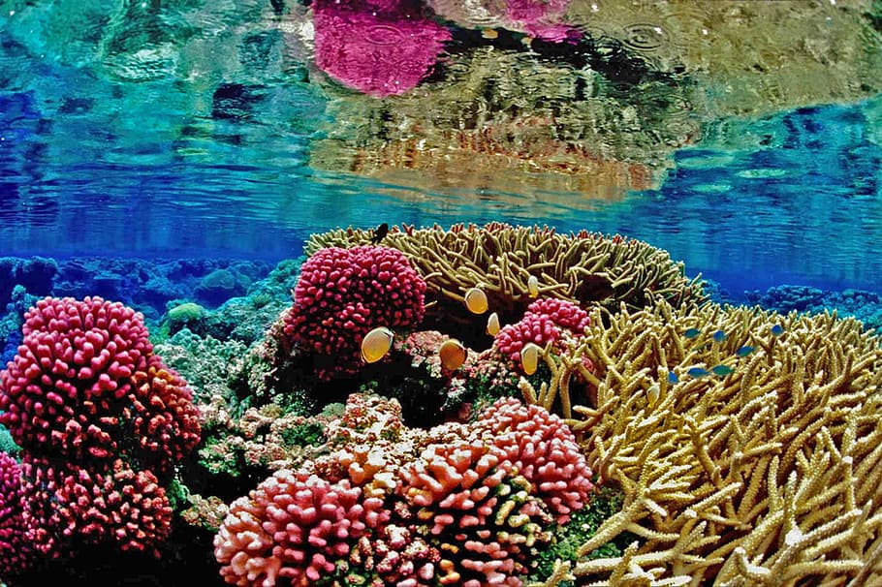
The film begins in the Great Barrier Reef and ends in Sydney, Australia, featuring open ocean in between.
Notes:
Emily

Slide 4
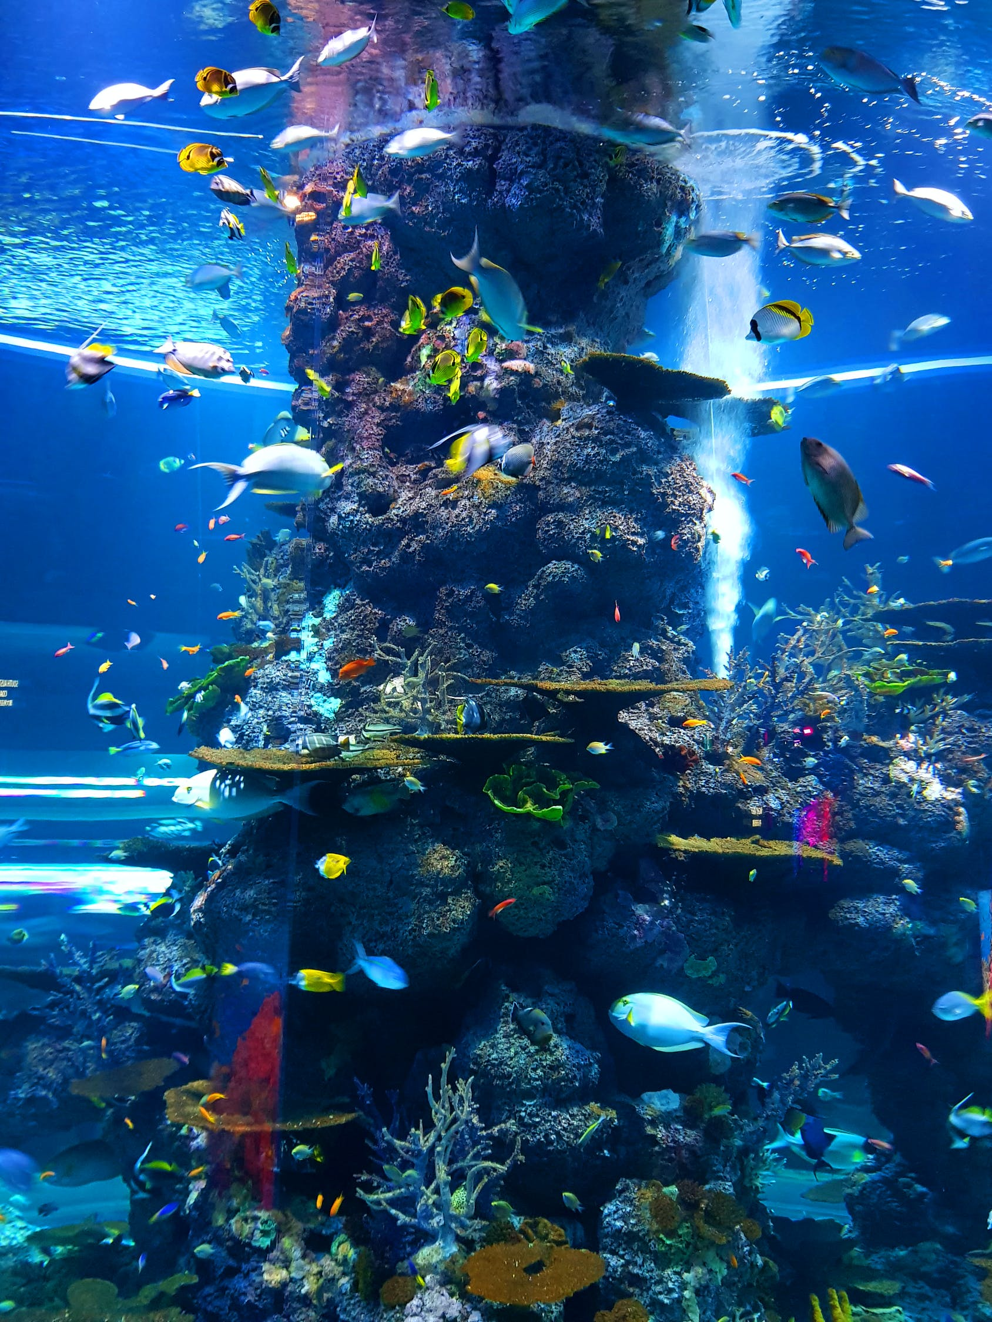
We chose this film because the fish
represented are real species,
not just generic cartoons.
Notes:
Emily

Slide 5
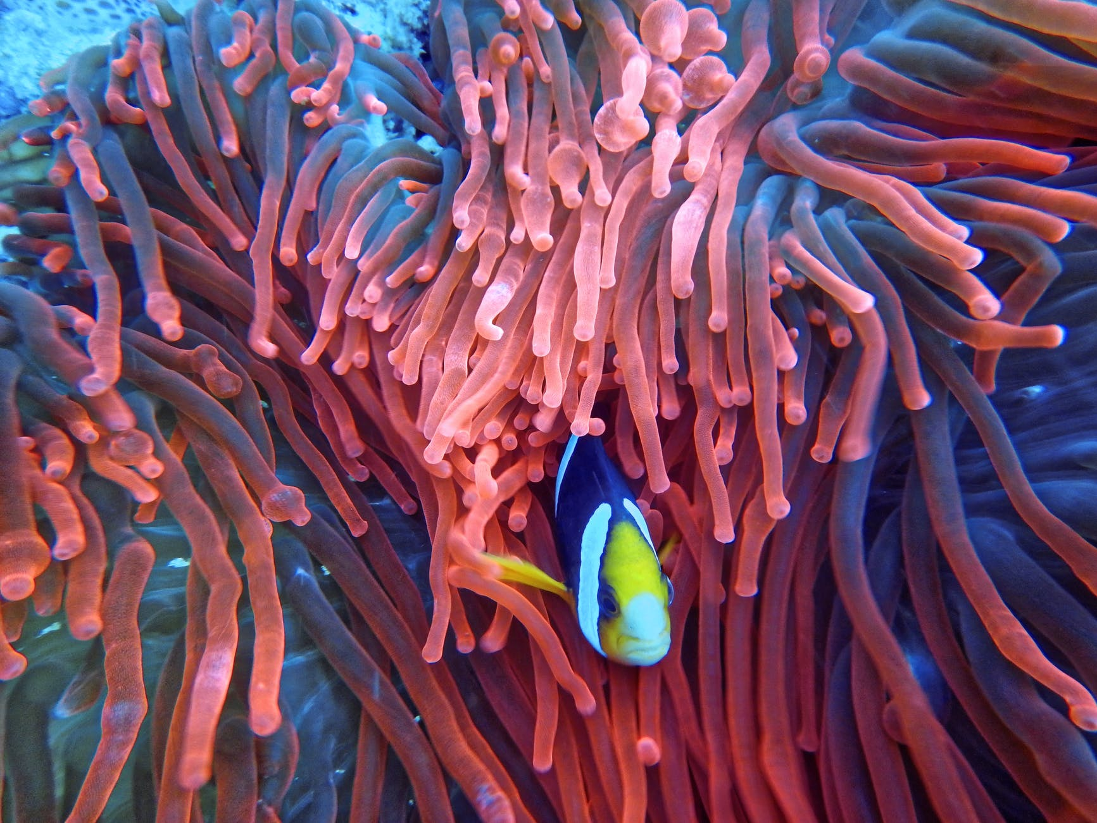
The animators of this film studied marine biology of the Barrier Reef while working on this film to maintain accuracy.
Notes:
Emily

Slide 6
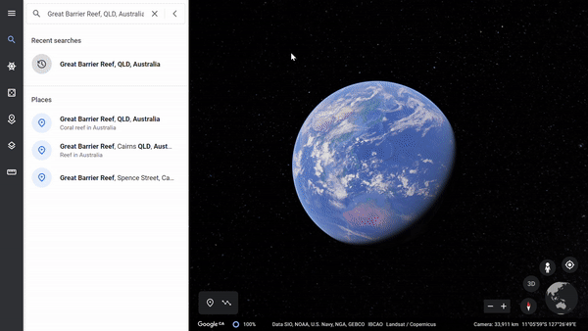
Research Questions
Objective 1: Are the species in the movie occuring in the same areas as their real-life counterparts?
Notes:
Indigo:

Slide 7
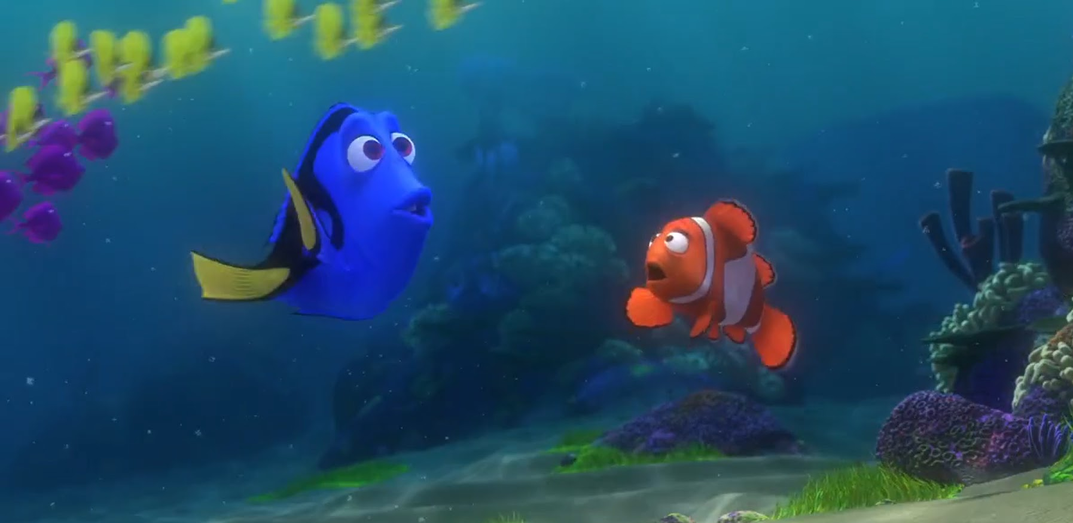
Research Questions
Objective 2: Are the species in the movie co-occuring in the same space with each other?
Notes:
Indigo: Like whether a clownfish would hangout with a blue tang in real life. With these objectives in mind, we head into data collection and analysis

Slide 8
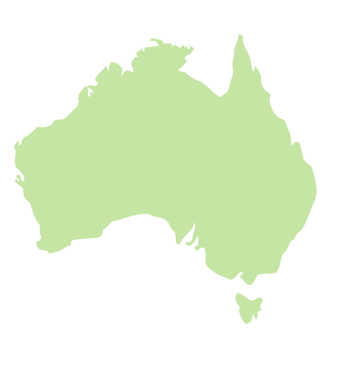
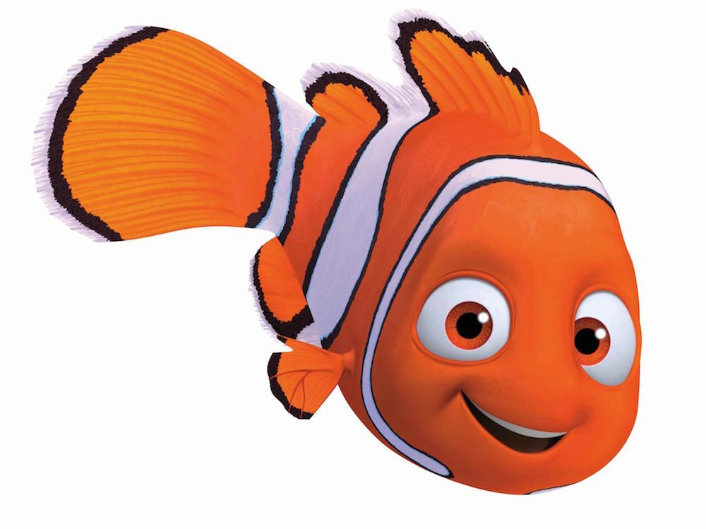
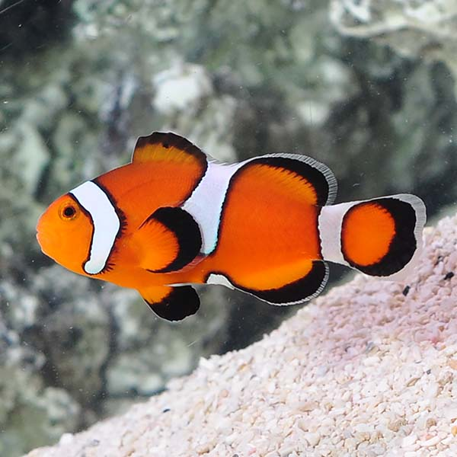
Data Collection
Which species are represented in the movie?
Where they are occurring?
?
?
?
?
?
Nemo
Amphiprion ocellaris

Slide 9
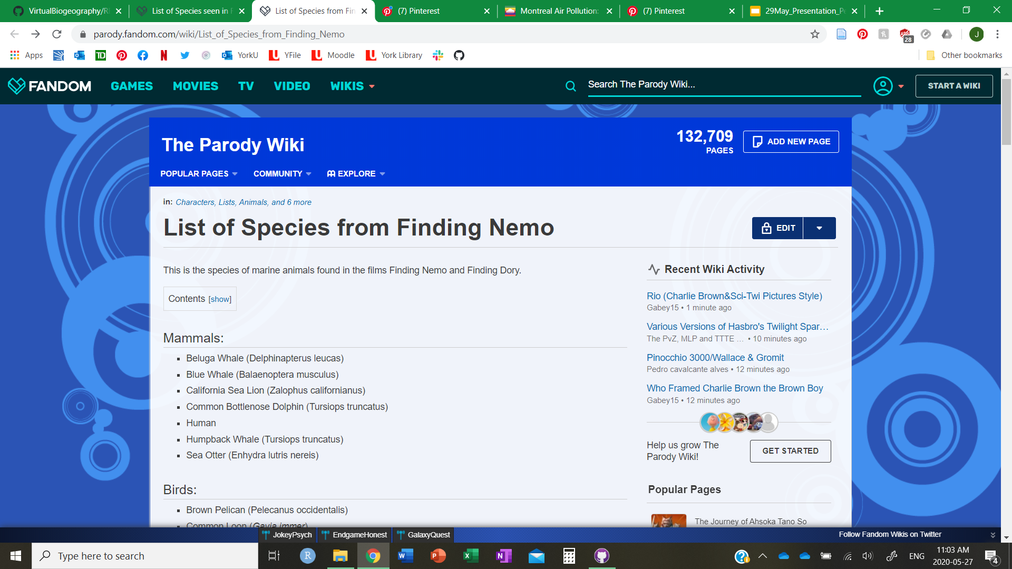
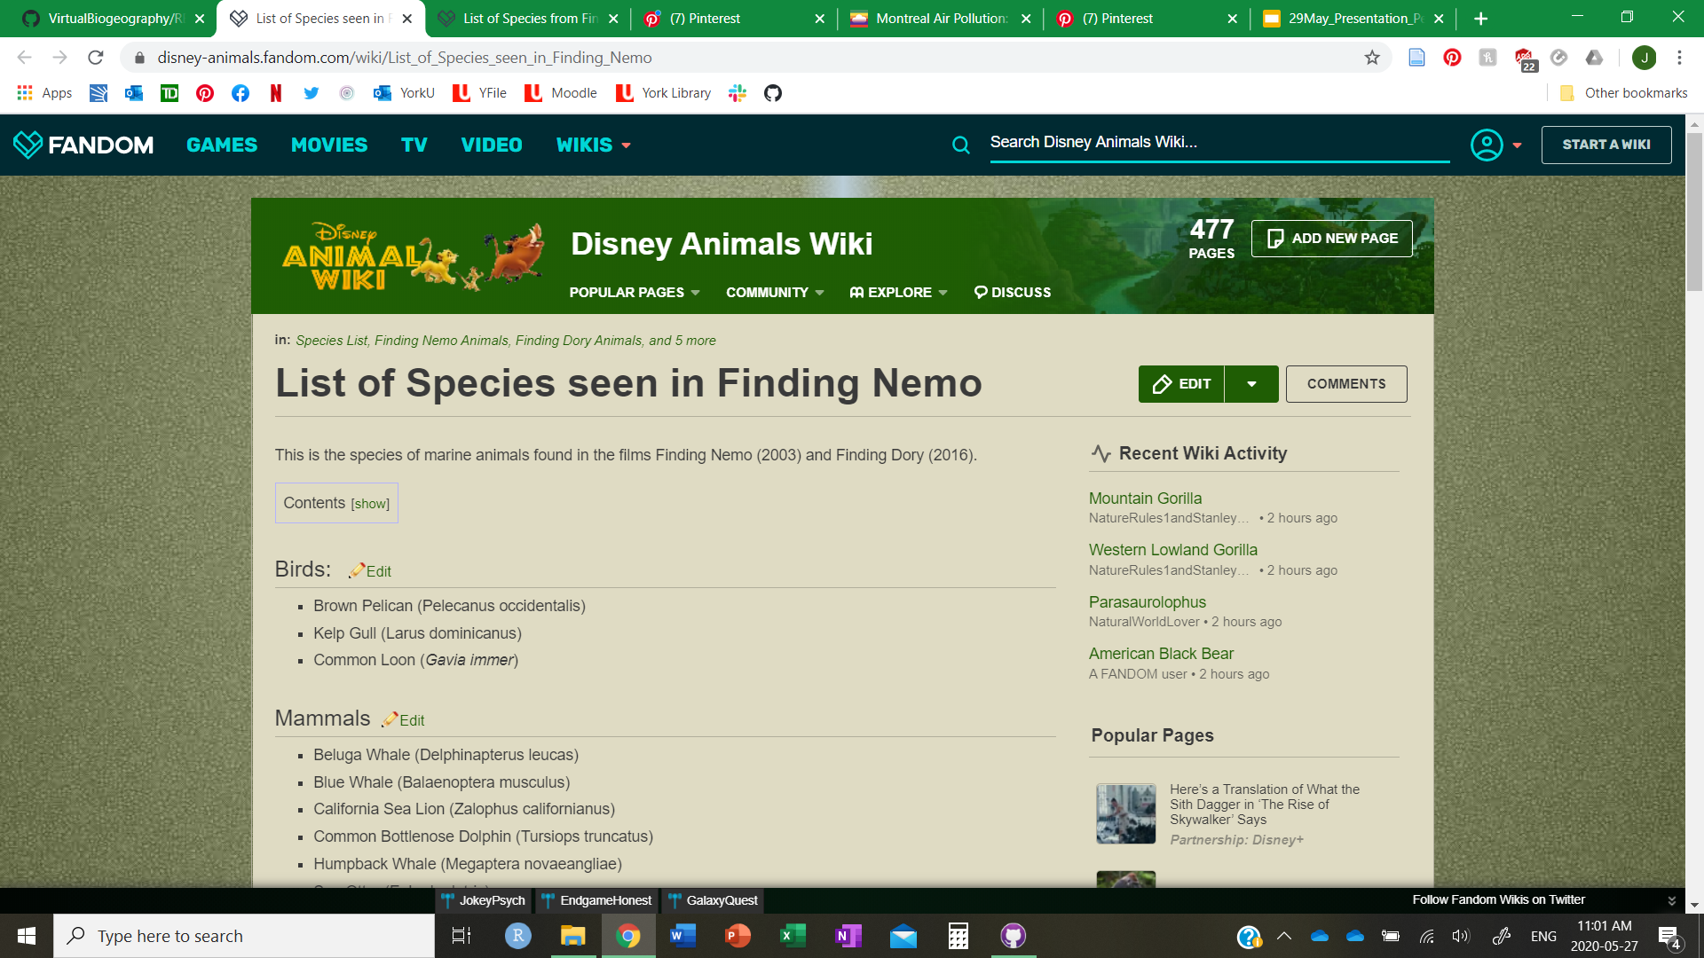
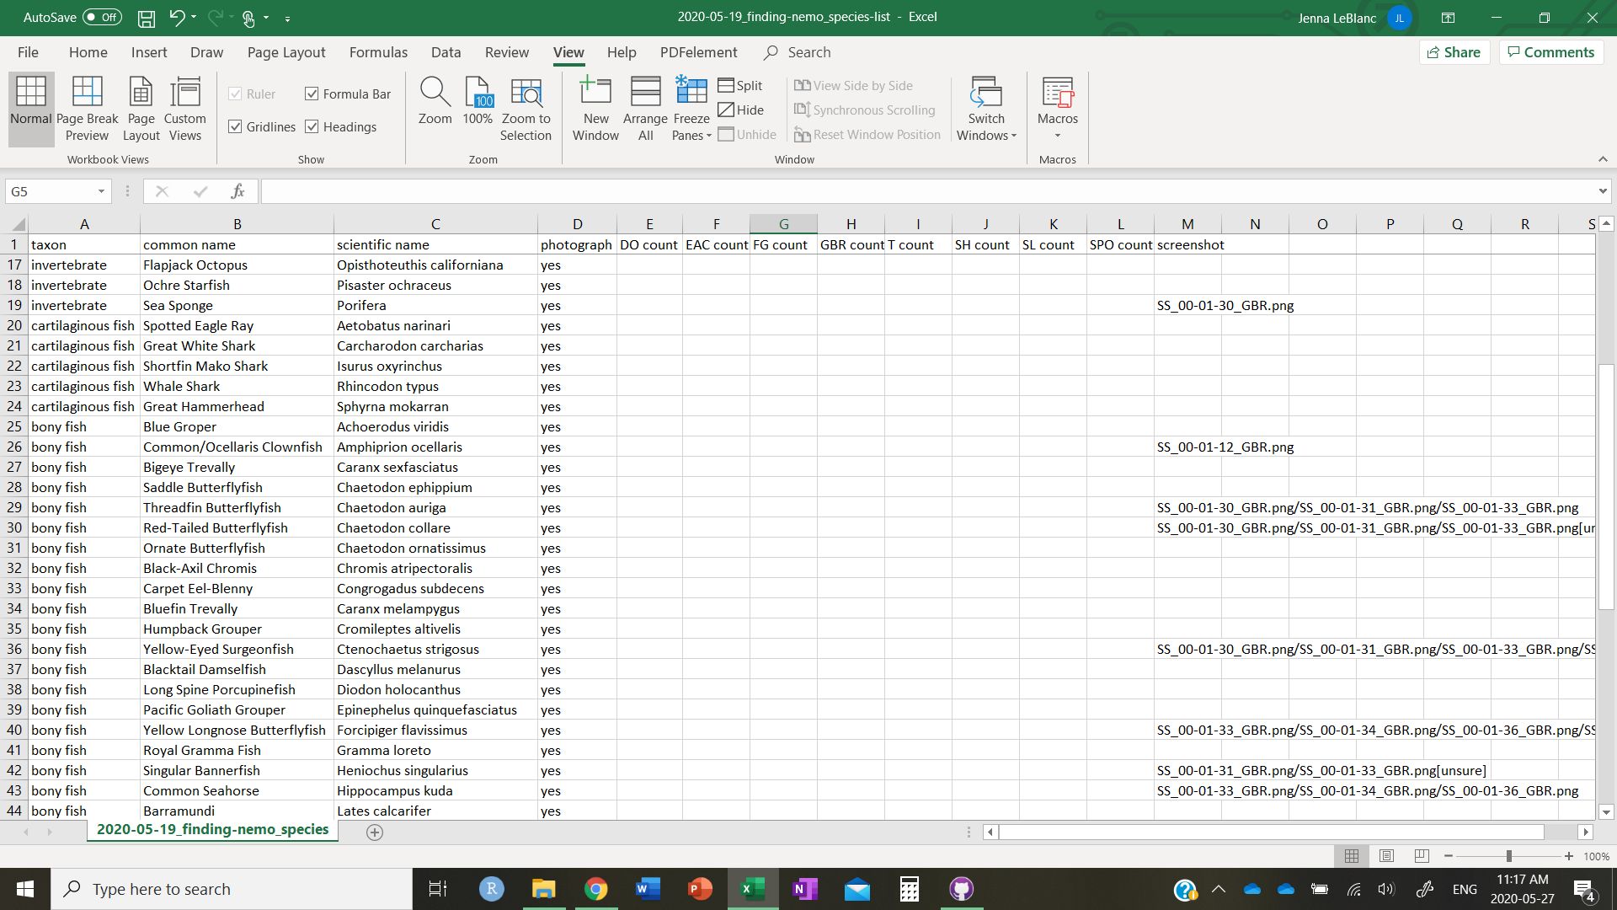
Data Collection
Species Reference List
Two separate fan-created lists
Merged and cleaned with OpenRefine
Final list of 65 species

Slide 10
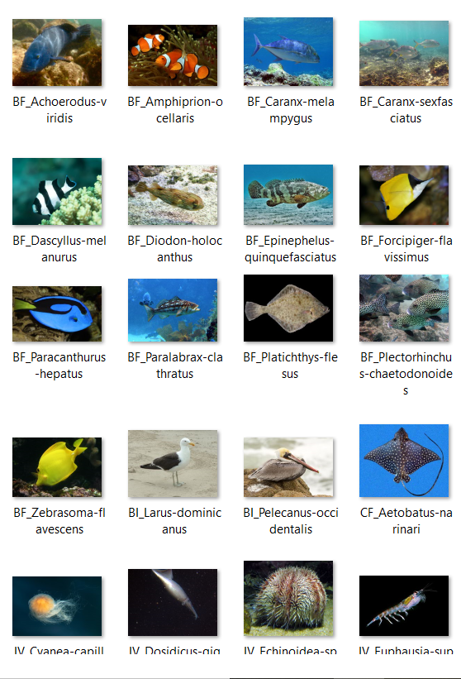

Data Collection
Species Reference Photos
Images sourced from Wikimedia Commons
Species labelled with taxonomic abbreviation and binomial name

Slide 11
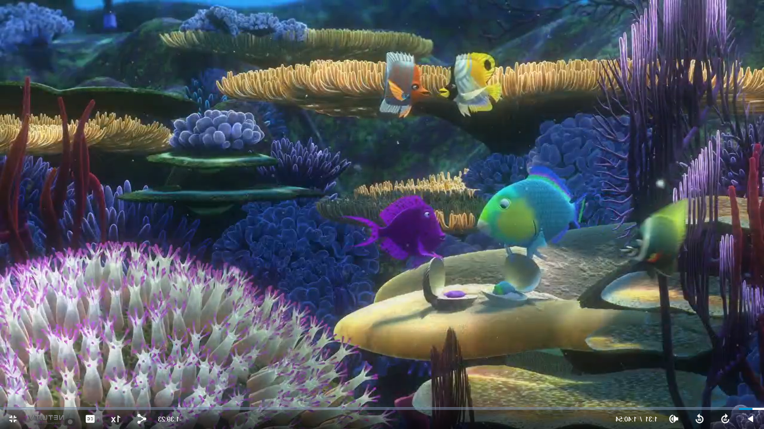
Data Collection
Screenshot of organisms from the movie
Not all species were recorded
Mainly species from the pre-established list

Slide 12
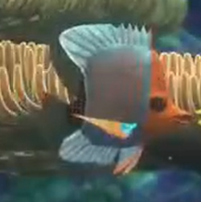
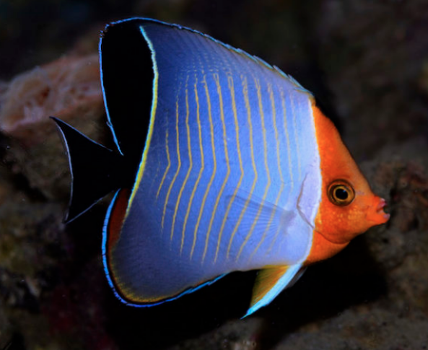
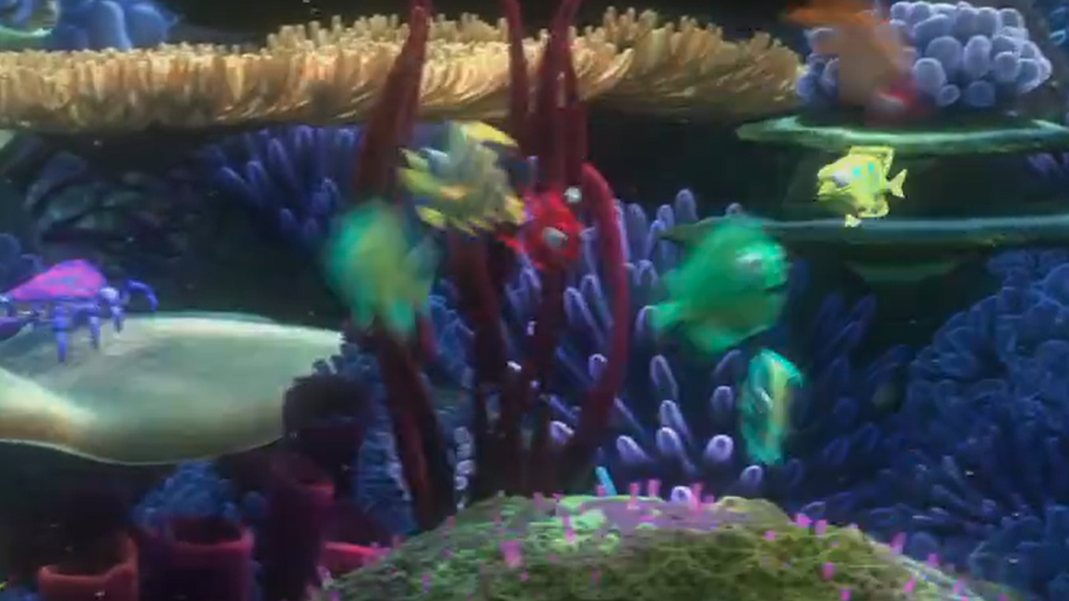
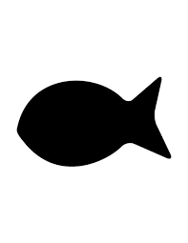
Data Collection
The limits of screenshots
?
→
Artistic depiction of some species
Generic “sponges” or “reef fish”
Embracing the blurriness
ERROR
?
Fish not found

Slide 13
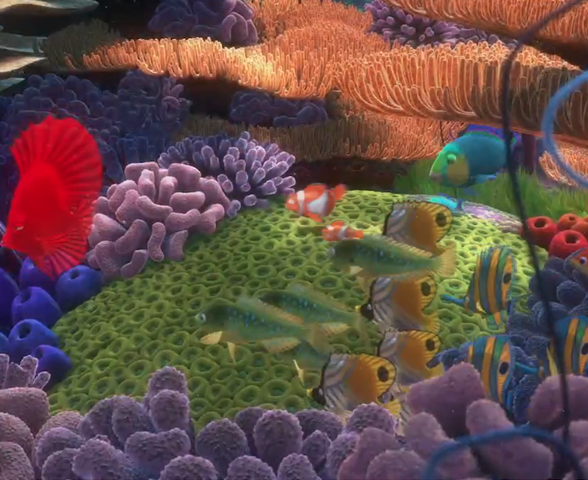
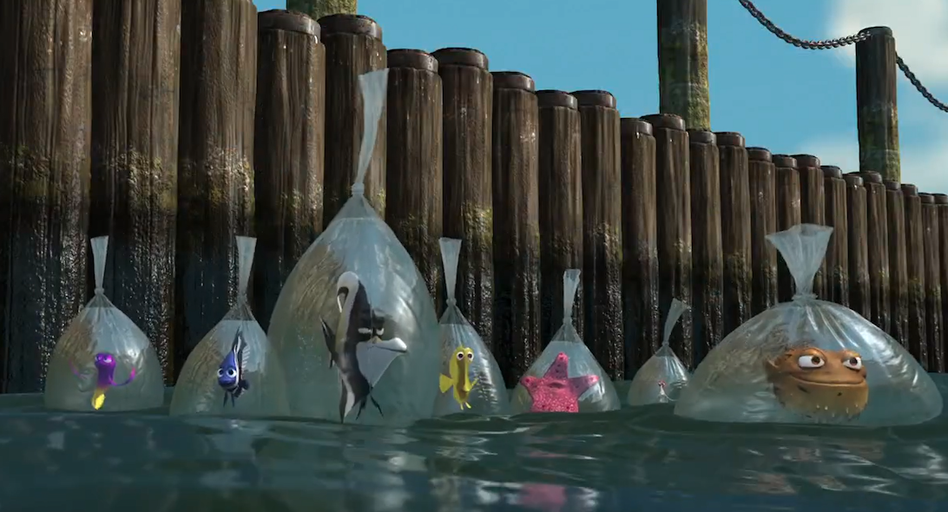
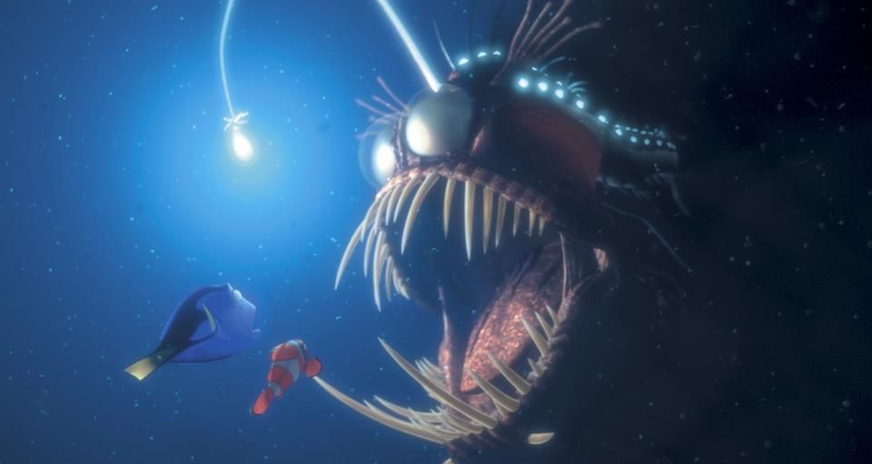
Our Datasheet
Species presence/absence per movie location
Pinpointing where these places were on a map
The Reef
Sydney Harbour
The Deep Trench

Slide 14
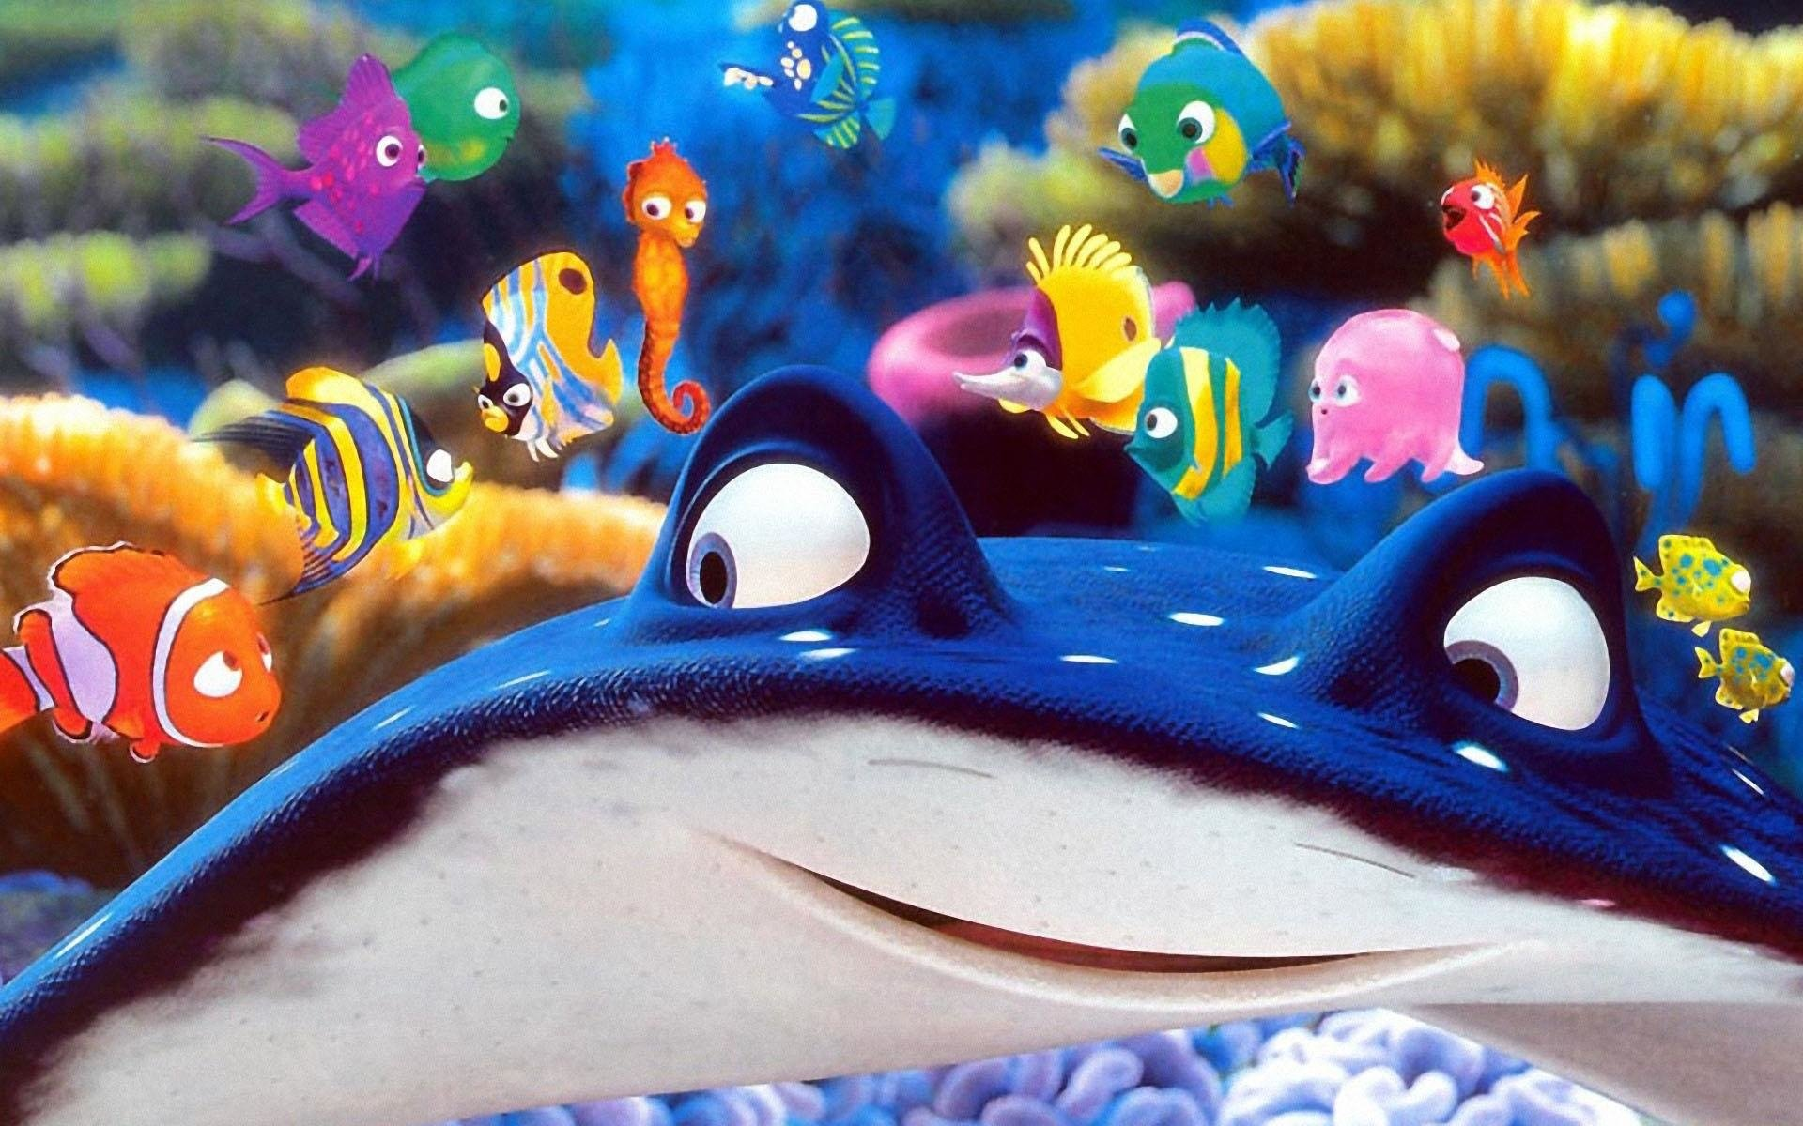
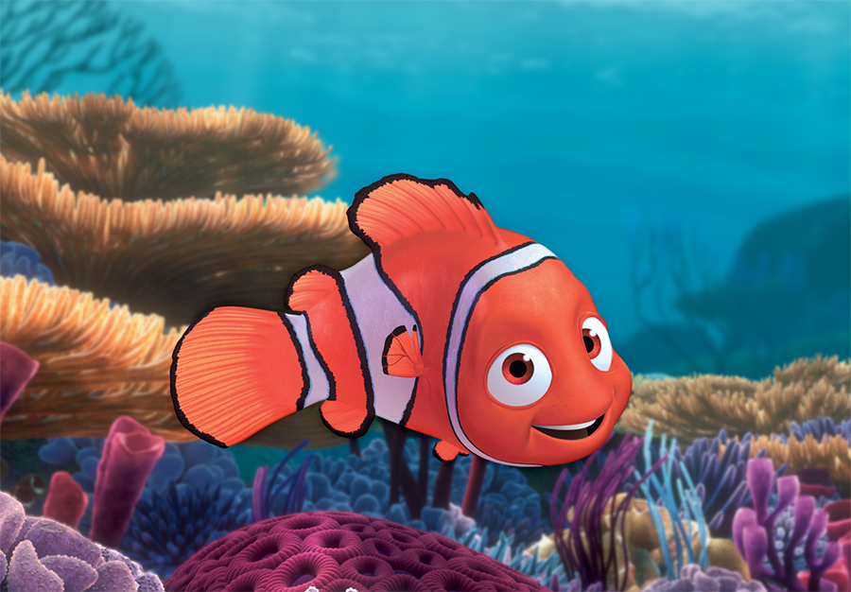
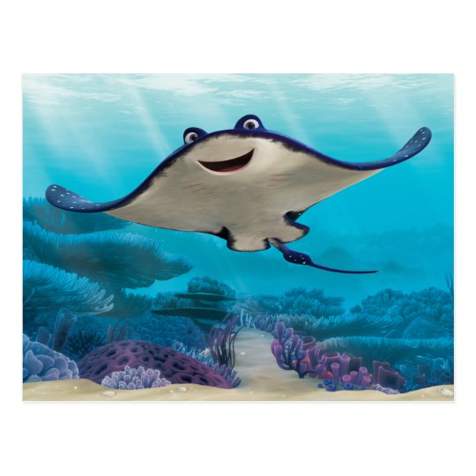
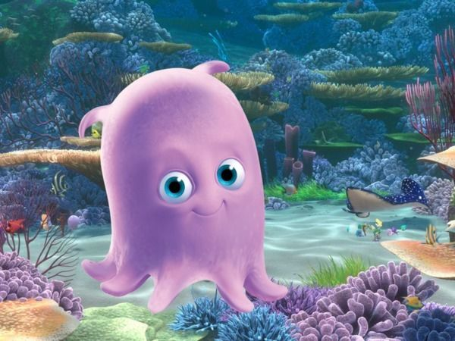
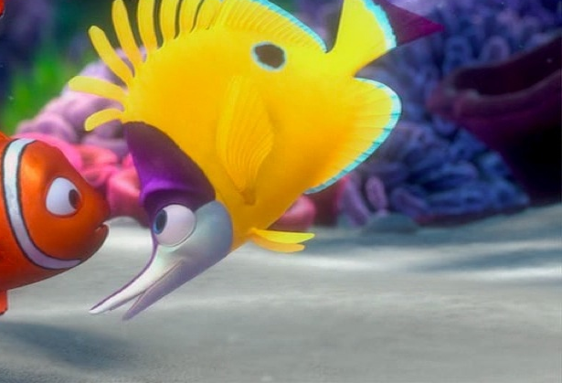
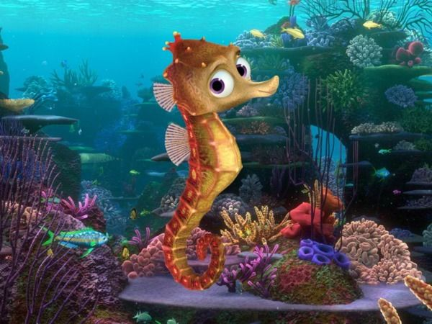
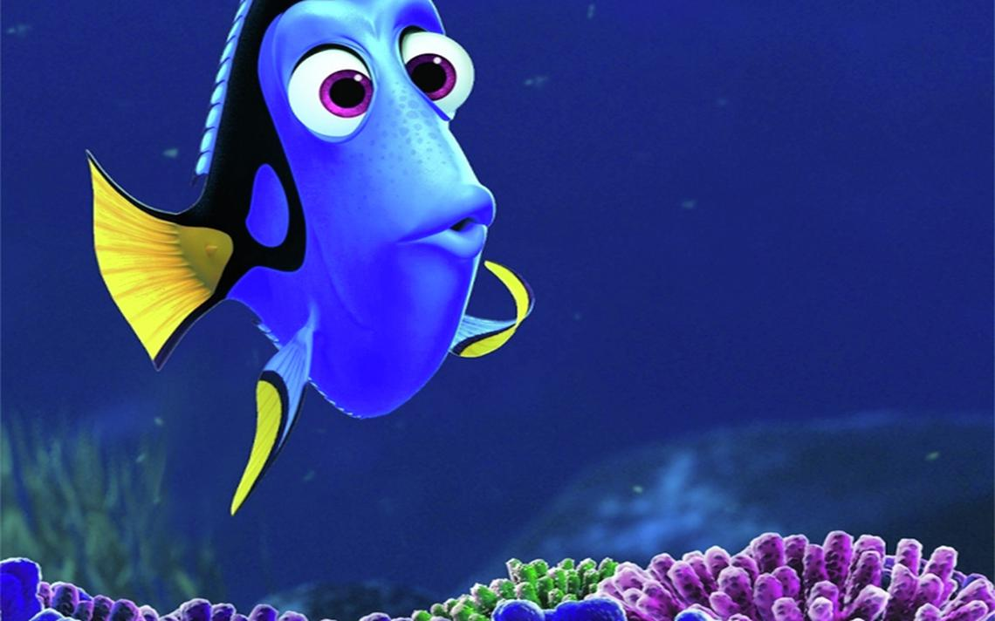
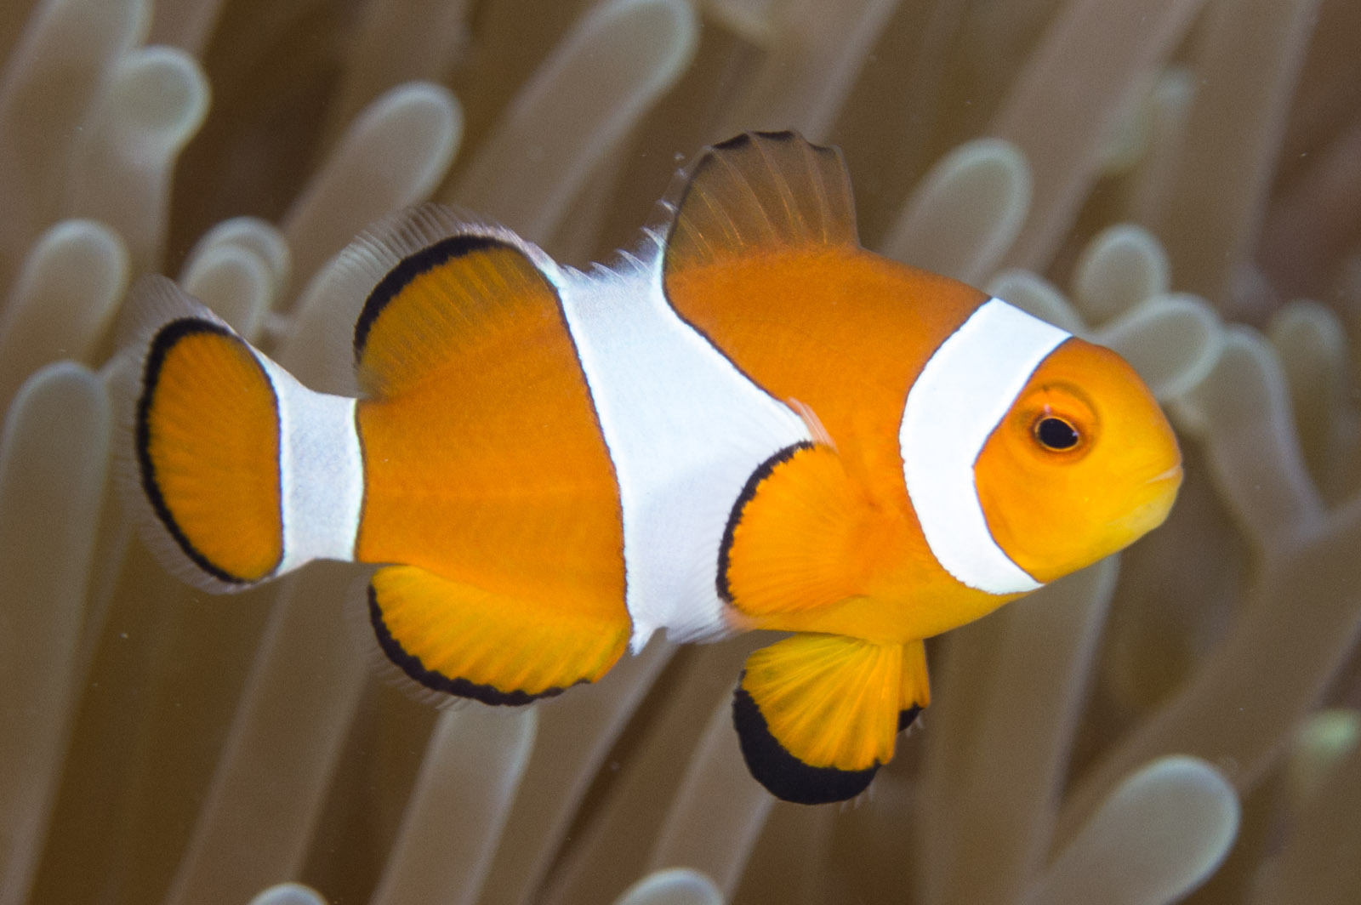
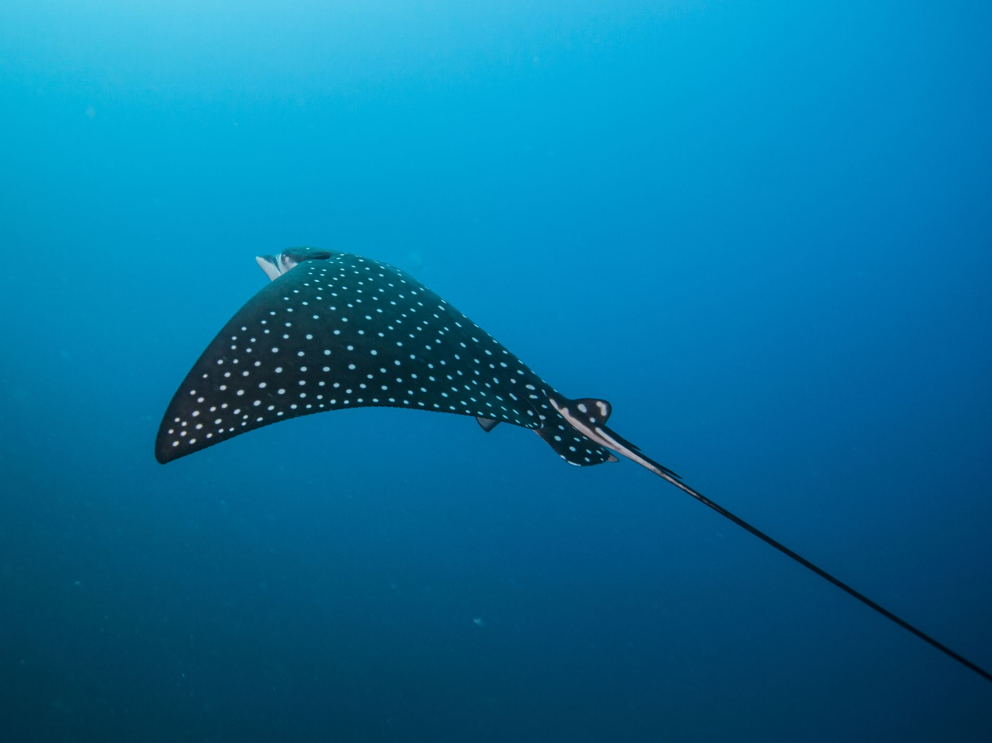
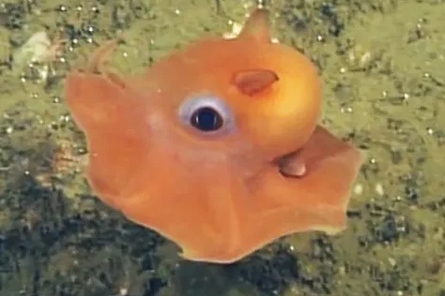
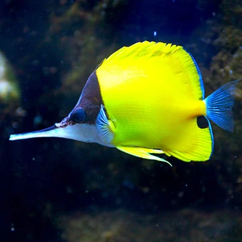
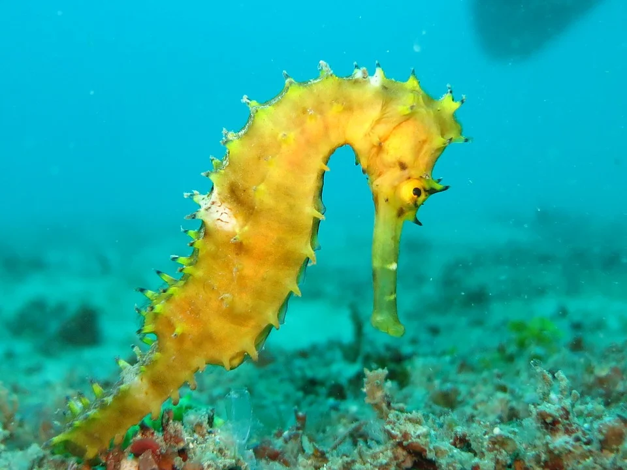
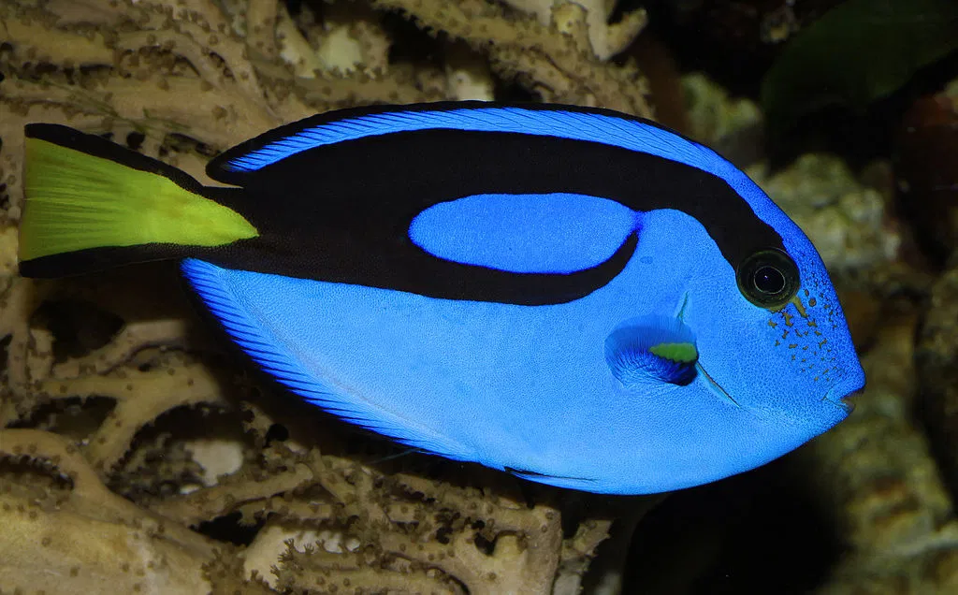
Data Collection: focal species
Six focal species chosen from Nemo’s class
Nemo Mr. Ray Pearl Tad Sheldon Dory
Amphiprion ocellaris
Aetobatus narinari
Opisthoteuthis californiana
Forcipiger flavissimus
Hippocampus kuda
Paracanthurus hepatus
Notes:
Amanda

Slide 15
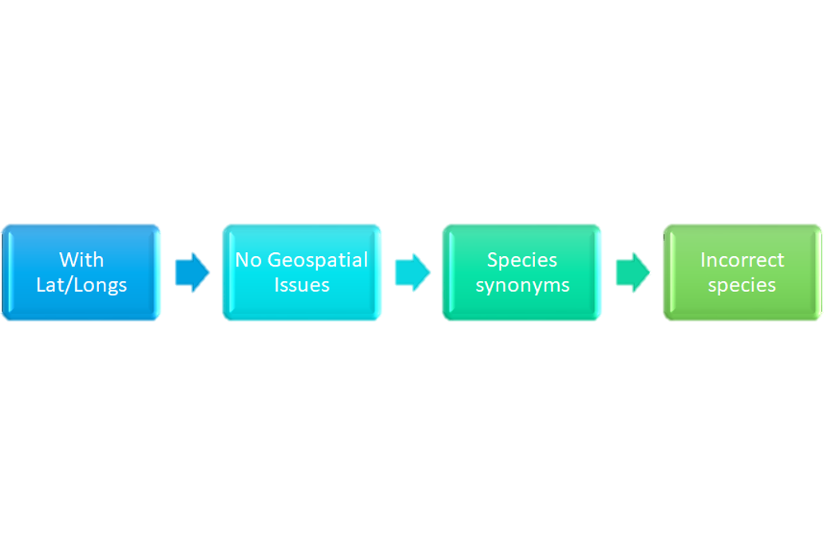
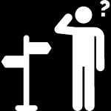



Data collection: GBIF occurrence records
In GBIF
In OpenRefine
Notes:
Amanda

Slide 16
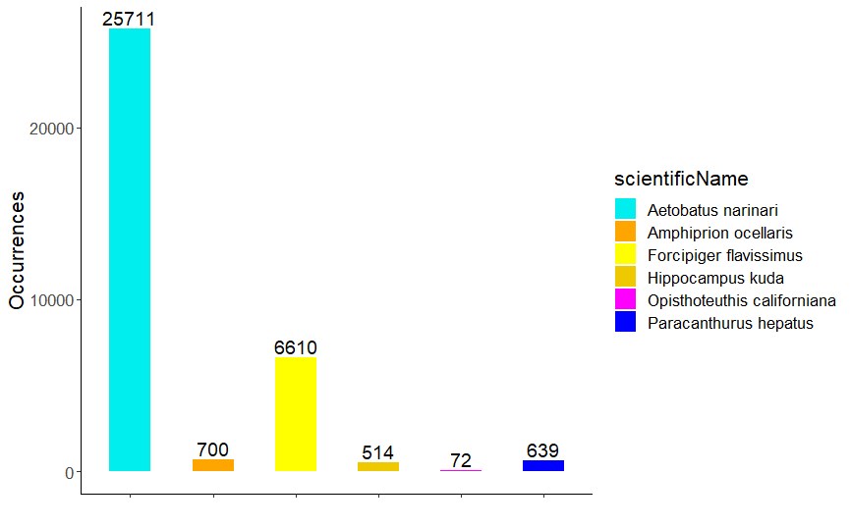
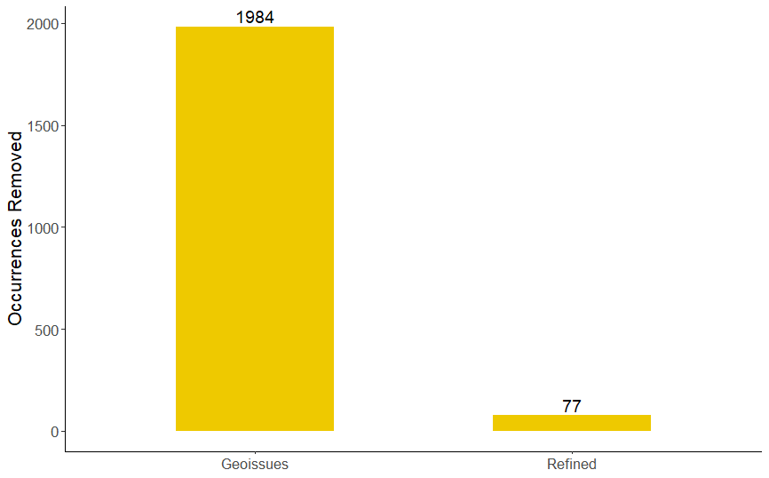
Occurrence data visualized
22 species
6 species
Occurrences removed during data cleaning
Occurrences by species in the final dataset

Slide 17
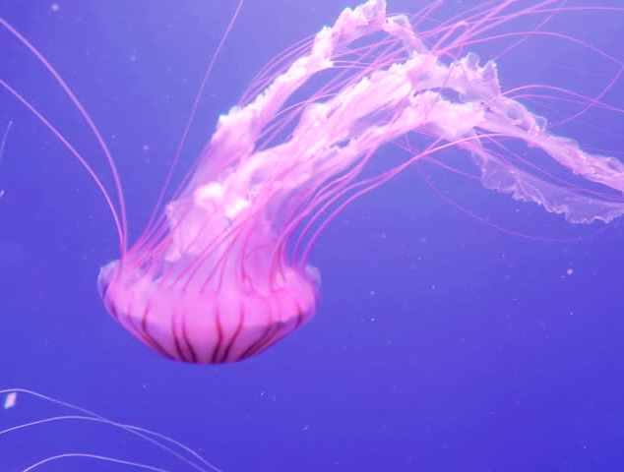

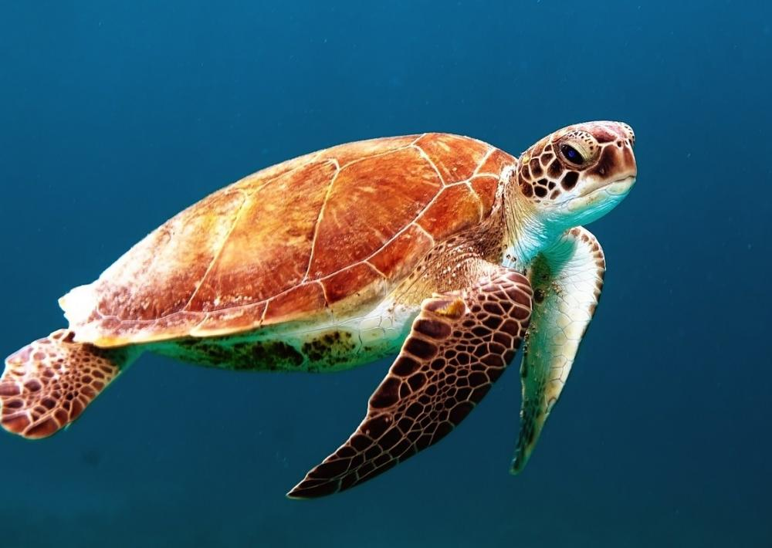
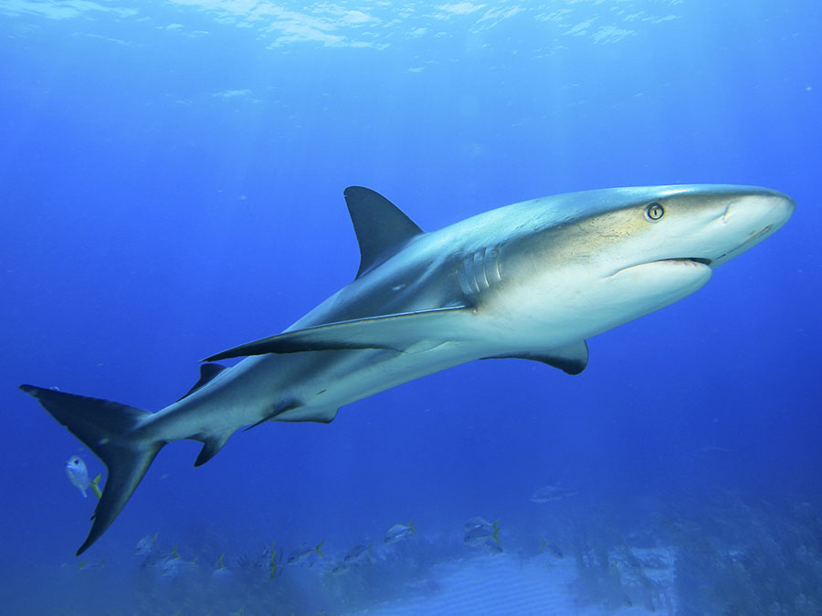
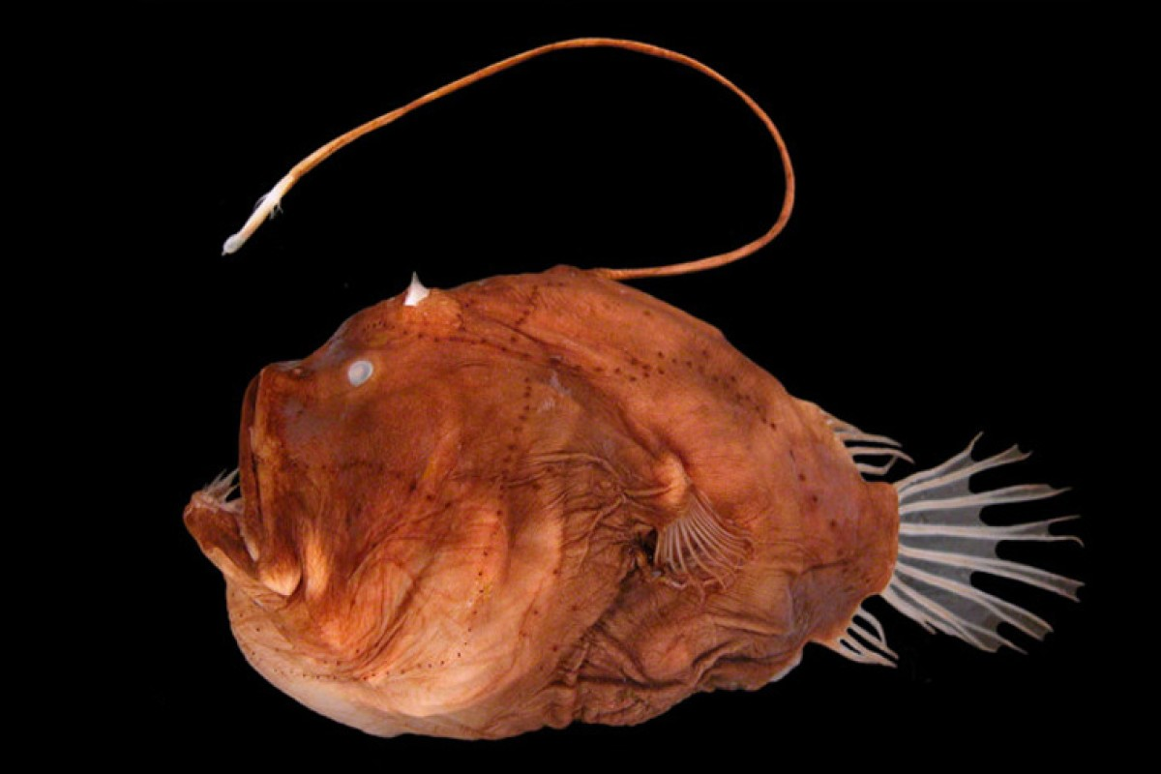
Data analysis
Minimum Convex Polygons to create species range maps
Species Accumulation Curves over movie duration
Notes:
Amanda

Slide 18
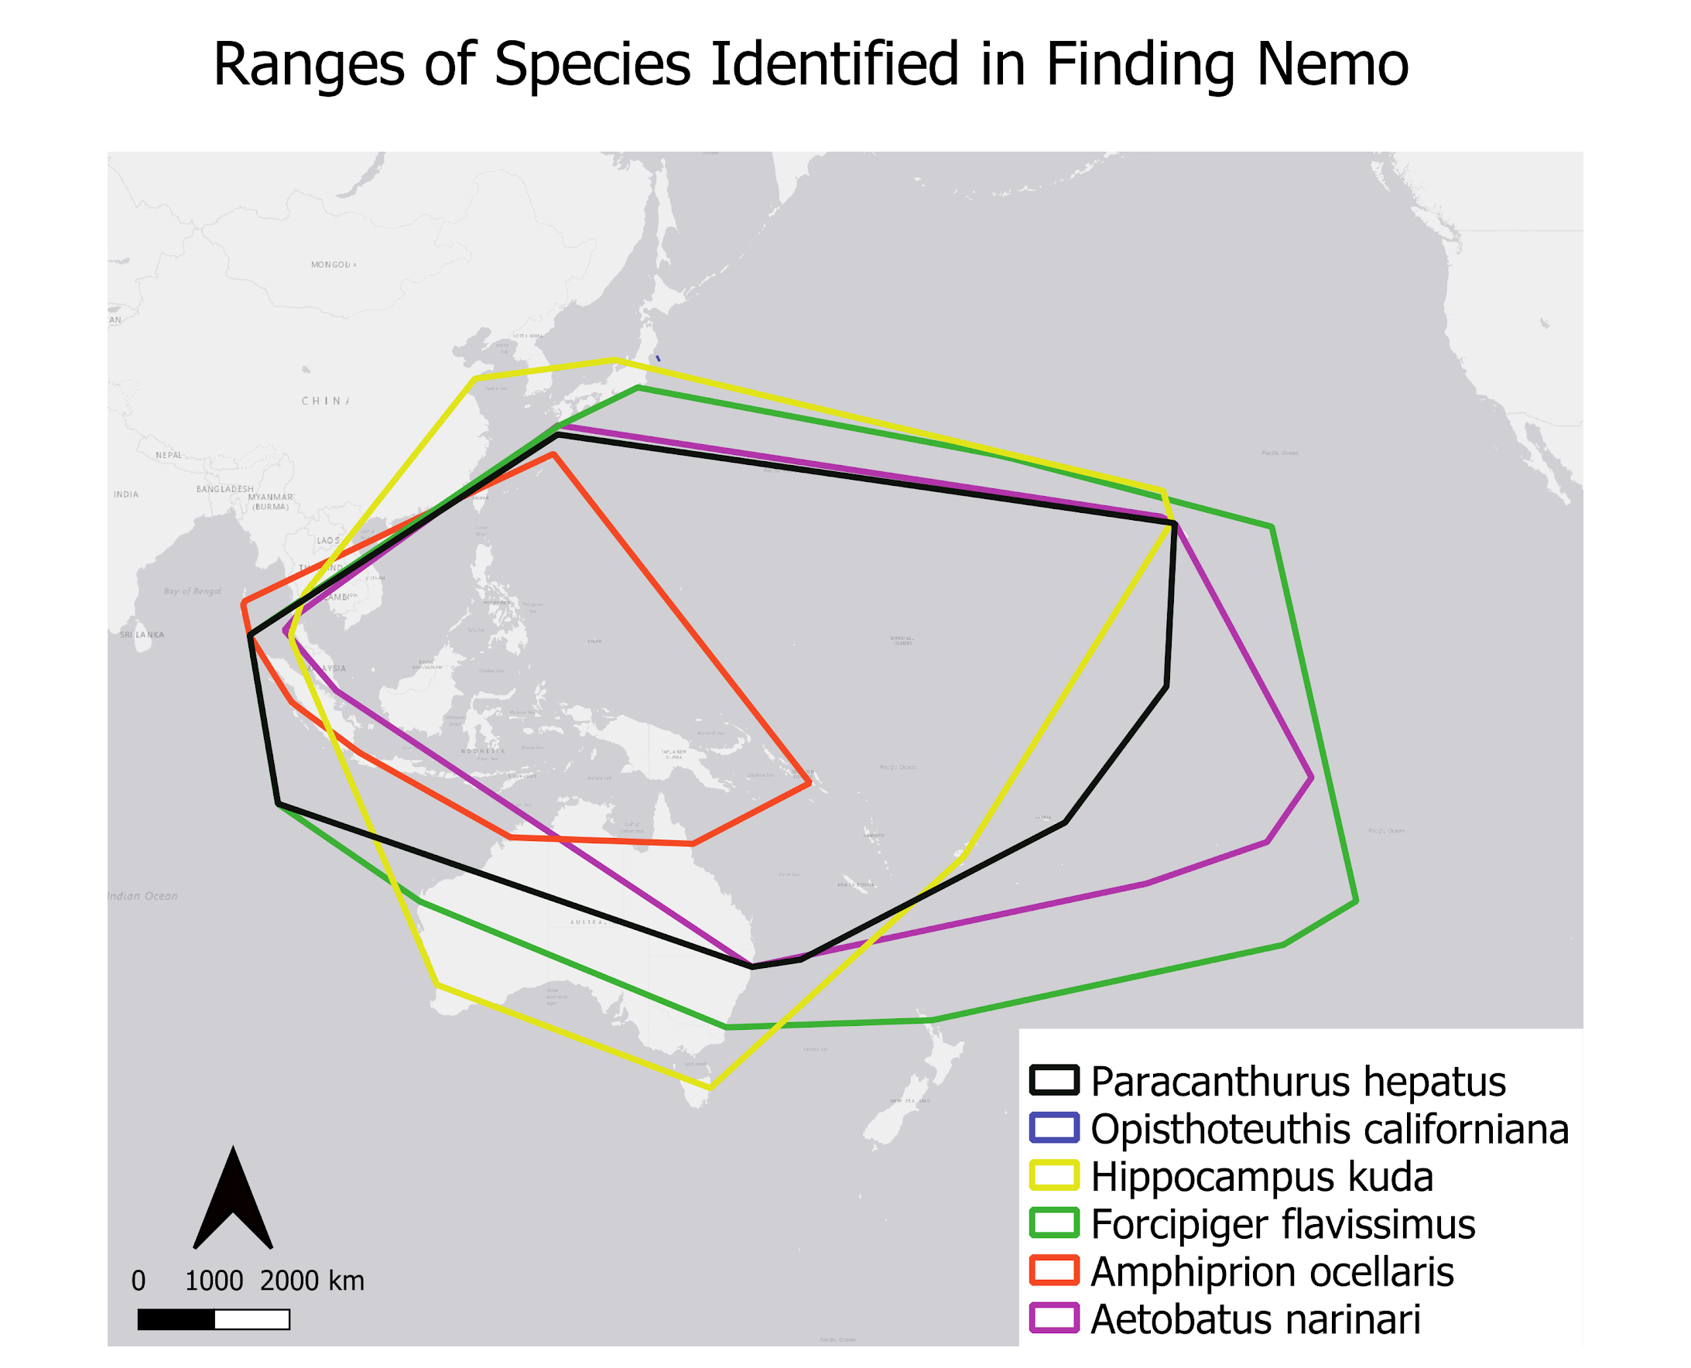
Expected results - map
Notes:
Indigo: We overlapping the range generated for each species to see areas where they could be co-occurring, then we reference this with the portrayal in the movie.

Slide 19
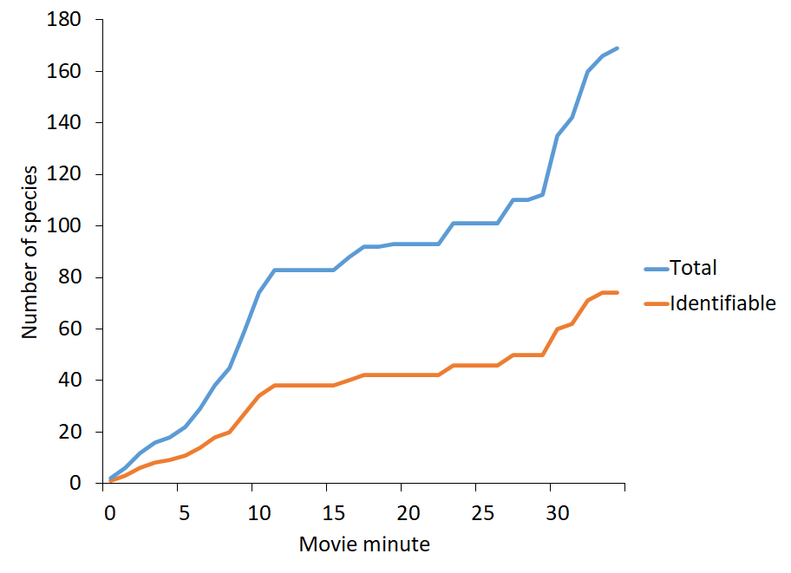
Expected results - graph
Species accumulation curves over the duration of the movie
Notes:
Indigo: this line graph is showing the species accumulation curve over time, with the blue line being the total number of species and the orange be the number of identifiable or correctly represented species in the movie. This graph presents

Slide 20
Q&A

